Slide 1
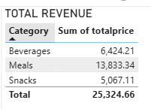
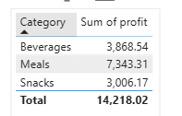
Analyst at TastyBites

Slide 2
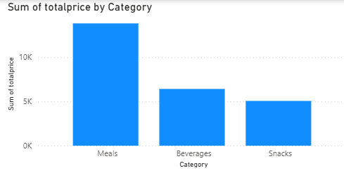
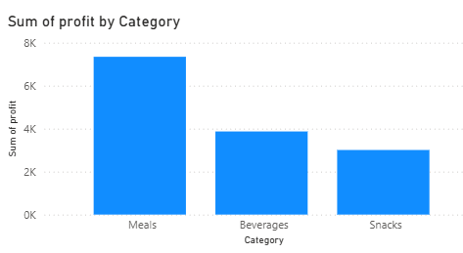
Revenue per Product
Profit Margin per Product

Slide 3
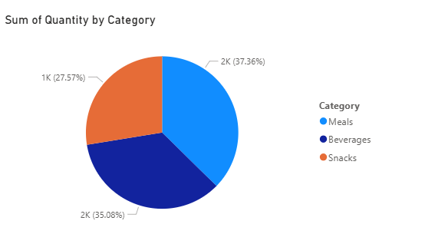
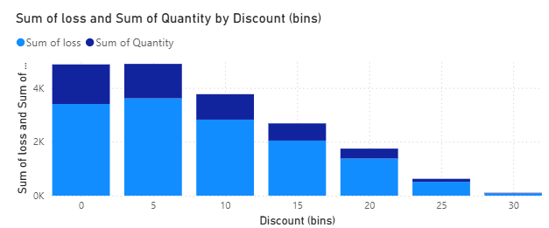
Units Sold
Discount Impact

Slide 4
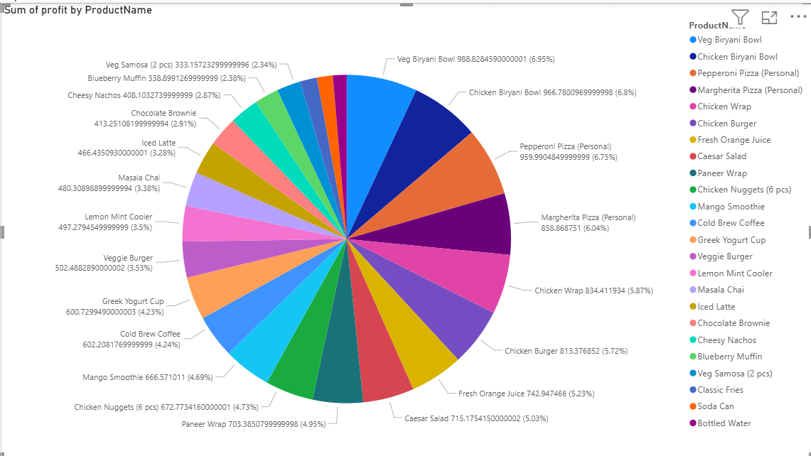
Contribution of each Iteam to Total Profit

Slide 5
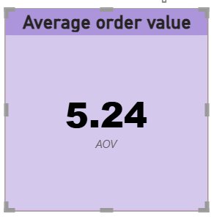
Average Order Value

Slide 6
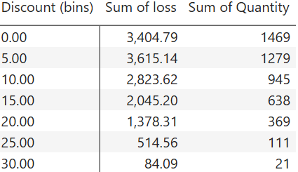
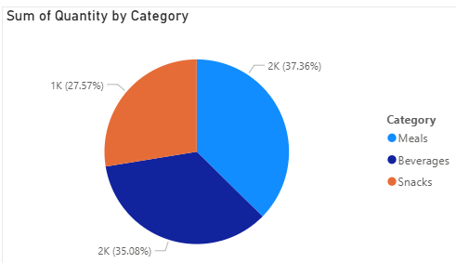
Solution of business problem
Discount play’s very important role in business, as we can see in data, when there is discount between 5-10%, there is a maximum number of order but this also decreases the profit. On the other hand discount of 25-30 doesn’t increase the sales, so we should remove the discount of more then 20 %.
In the data, we can clearly see that the meal categories have the maximum number of orders and give the company maximum profit, so we do not need to increase the discount on meal category items
We have very few sales of snack items, there is a requirement to increase sales by giving more discount.

Slide 7
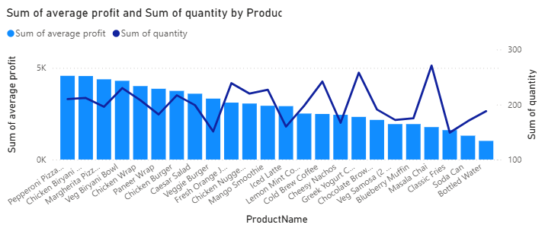
In the graph, Masala chai item has very high sale but it gives very low profit to the company, so there is a need to increase the price of chai and remove the discount on this item.
Items like Pizza and biryani give high profit and good sale, if we want to increase the revenue of the company, we can give some discount to such items and increase sales.

Slide 8
Items like paneer roll and veggie burger give high profit but have very low sales. We should do a promotion to increase the demand, which will result in an increase in profit.

